Slide 1


WELCOME
30th Annual
Convention & Trade Show

Slide 2

#NARPM2018

Slide 3


Building a Killer Lease Agreement
By Robert Locke
RMP, MPM
And Attorney
Monica Gilroy

Slide 4
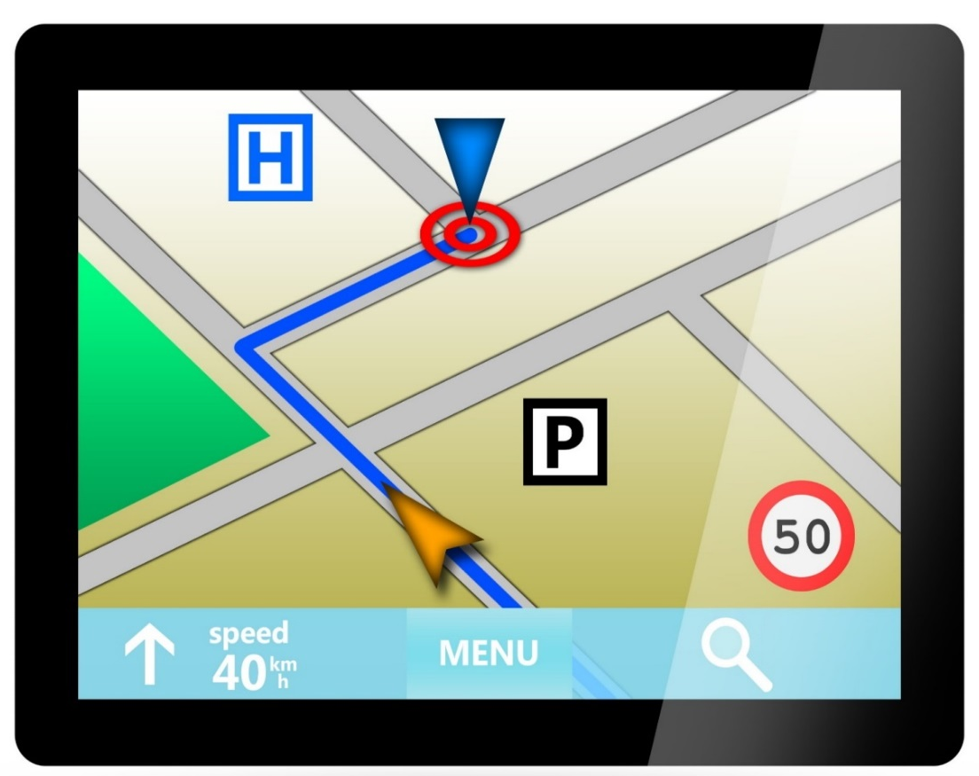
Today’s Agenda
Big Picture
Things You NEVER Put in Your Lease
Things You ALWAYS Put in Your Lease
Notes:
4

Slide 5


35 Years as Crown Realty & Management
Sold in 2015
Now a vendor

Slide 6

Is the Landlord/Tenant
Relationship So…..?

Slide 7

Adhesion
Contract
A contract between two parties with vastly different bargaining power.

Slide 8

Rental car
Hospital admissions
Mortgage
Insurance contract
HOA documents
Home warranty

Slide 9


Characteristics
Standard Form Boilerplate
Written & Controlled by One Party
No Opportunity to Negotiate
Customer Must Take It or Leave It

Slide 10




Consumer Protection Laws Written to Prevent Abuses
Courts Scrutinize to Prevent Oppressive or Unconscionable Terms
Enforcement
is Questionable

Slide 11
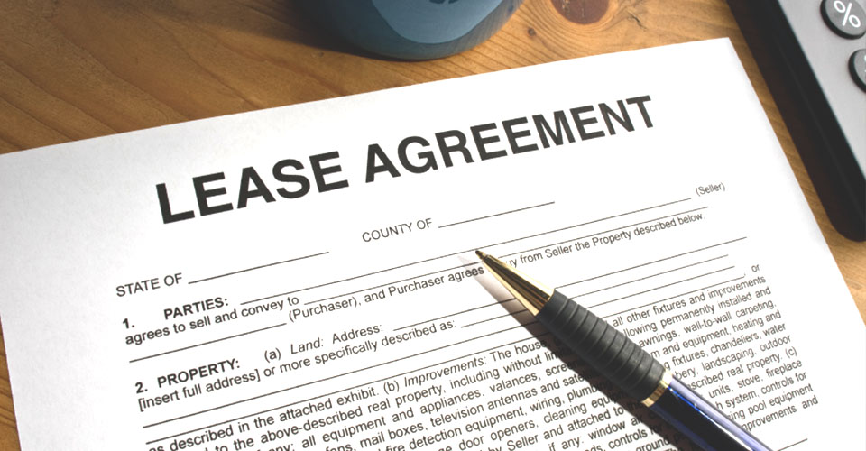
Adhesion
Contract

Slide 12
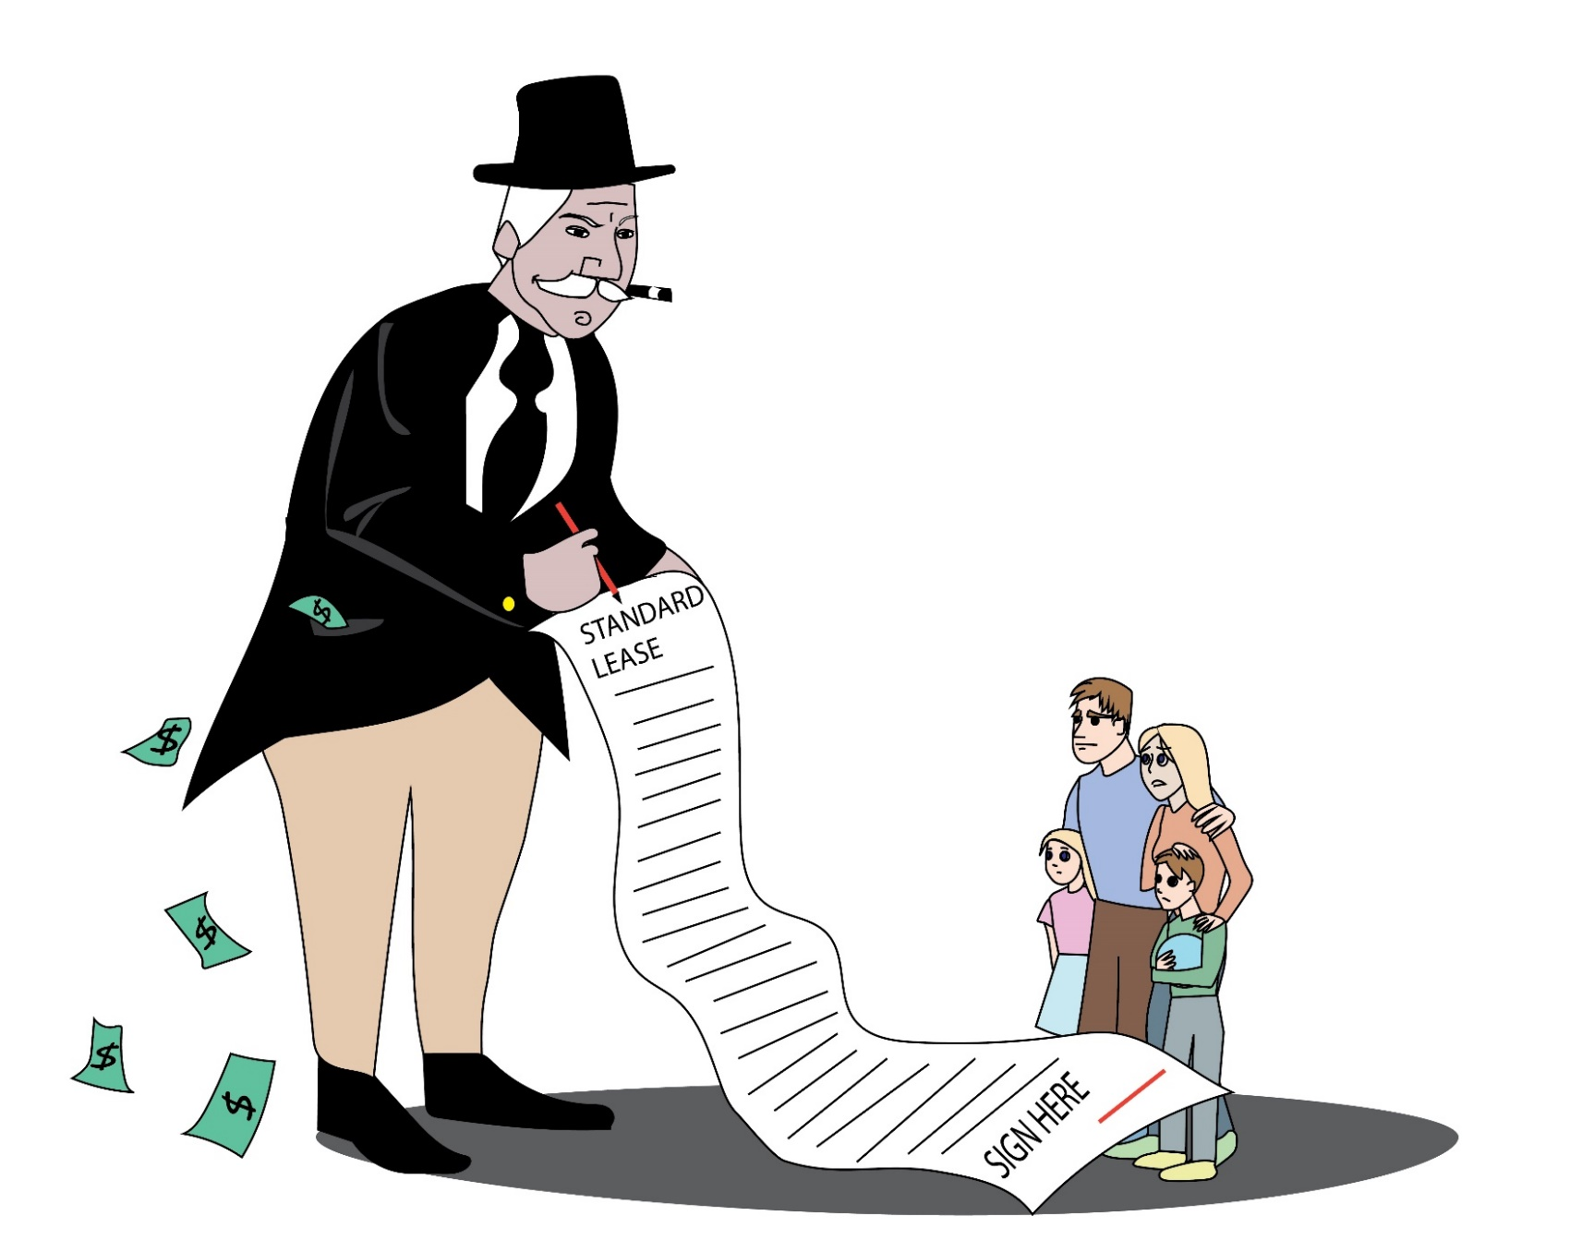
The Landlord has All the Power.

Slide 13
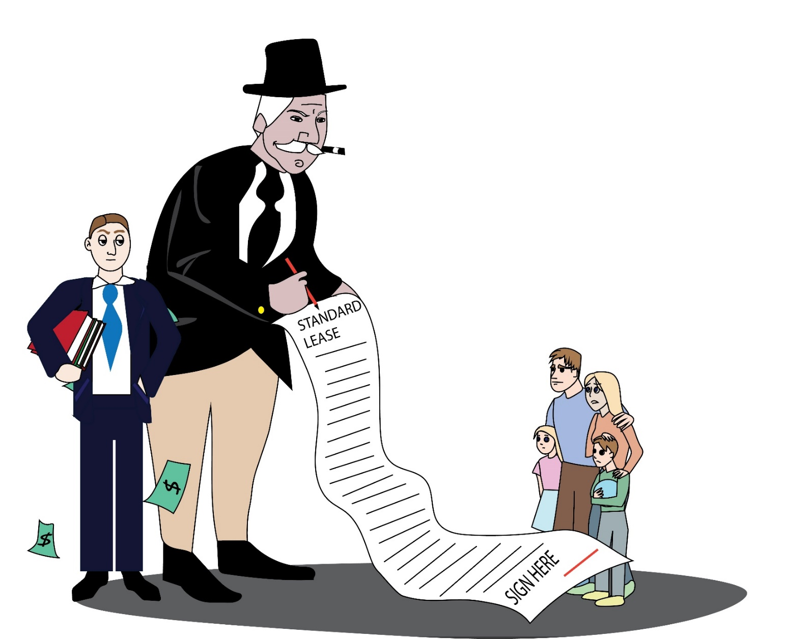
The Landlord Hires Help.

Slide 14



Other Relationships ?

Slide 15

Government Regulations
Laws designed to protect consumers from abuses by people who have undue power over others.

Slide 16
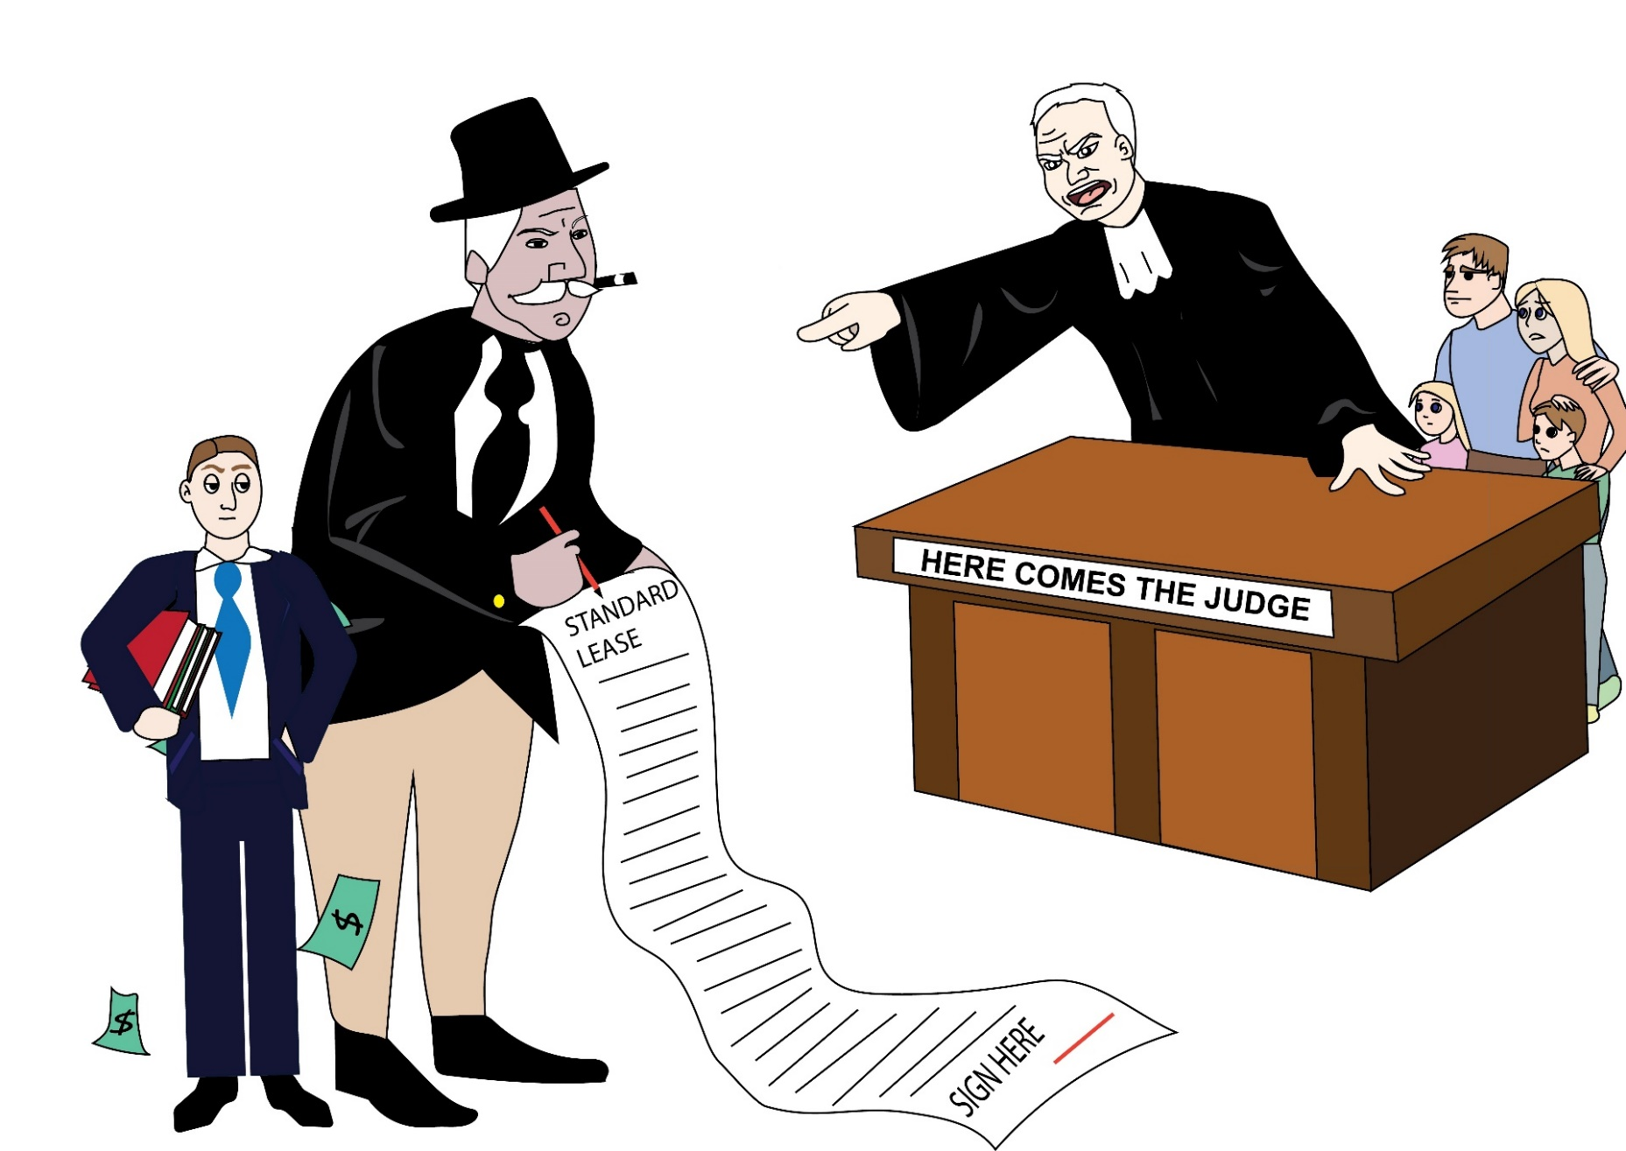
Courts Protect Tenants

Slide 17

2 Management
Styles
4 Lease
Configurations

Slide 18
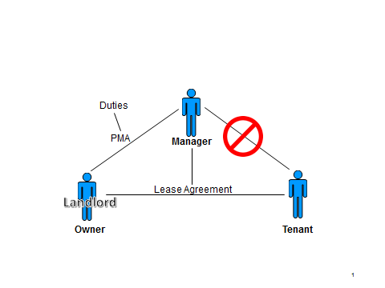
Broker Style
Promises
3 lease configurations

Slide 19
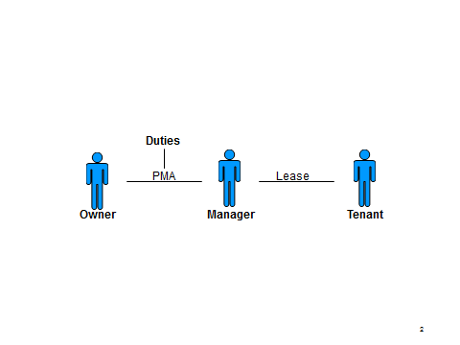
Manager Style
Promises
Promises
1 lease configuration

Slide 20

Broker Style
Owner signs the lease for self
Manager signs for company

Slide 21

Broker Style
Manager signs the lease FOR owner
Manager signs for company

Slide 22

Broker Style
Owner signs for self
Manager doesn’t sign.

Slide 23

Manager Style
Manager signs the lease for the company.

Slide 24

Conclusion
1. There are different ways to do leasing
2. Some are more scalable than others
3. You’ll evolve over time.

Slide 25
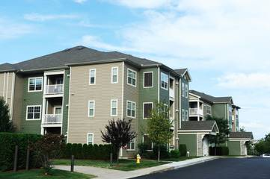
The apartment industry taught me this.

Slide 26

I Love
My
Rental Property
Notes:
26

Slide 27

A Vacant Property
is a
Money Pit
Notes:
27

Slide 28

The Tenant
is the
Asset
Notes:
28

Slide 29

It Changes the Way You Think
Long-term tenants make you money
There’s NO MONEY in procurement fees
Affects your attitude
Affects the renewal process.

Slide 30
Conclusion
Change your thinking about tenants and you’ll make more money AND make
your business more valuable.

Slide 31
Things You NEVER Put in Your Lease

Slide 32

#1
Things that Put the Tenant in Harms Way
Tenant agrees to:
Keep gutters clean
Do all minor repairs
Pay the first $50 of all maintenance
Climb ladders.

Slide 33
#1
Things that Put the Tenant in Harms Way
Tenant agrees to:
Do the repair if they broke it
If it wasn’t broken at move in, they must fix it.

Slide 34


#1
The health and safety of the resident
Potential conflict with owners
Face the owner vs face the judge.

Slide 35

#2
Things You Are Not Able
(or Don’t Have System in Place)
to Monitor and Enforce
No pets over 10 pounds
Outside pets only
Pets on a leash
Change filters quarterly.

Slide 36

The Owner has the Right to Expect…
If it’s in the lease, it’s enforceable
You’re the professional, you should know
You wrote the lease terms
It’s your job to enforce the lease.

Slide 37
#2
Things You Are Not Able to (or Don’t Have a System in Place to) Monitor and Enforce
No guests over 10 days
Set temperature at 70
Mandatory renters insurance
No smoking
WHY?

Slide 38

contractualize what you can’t track or enforce!

Slide 39
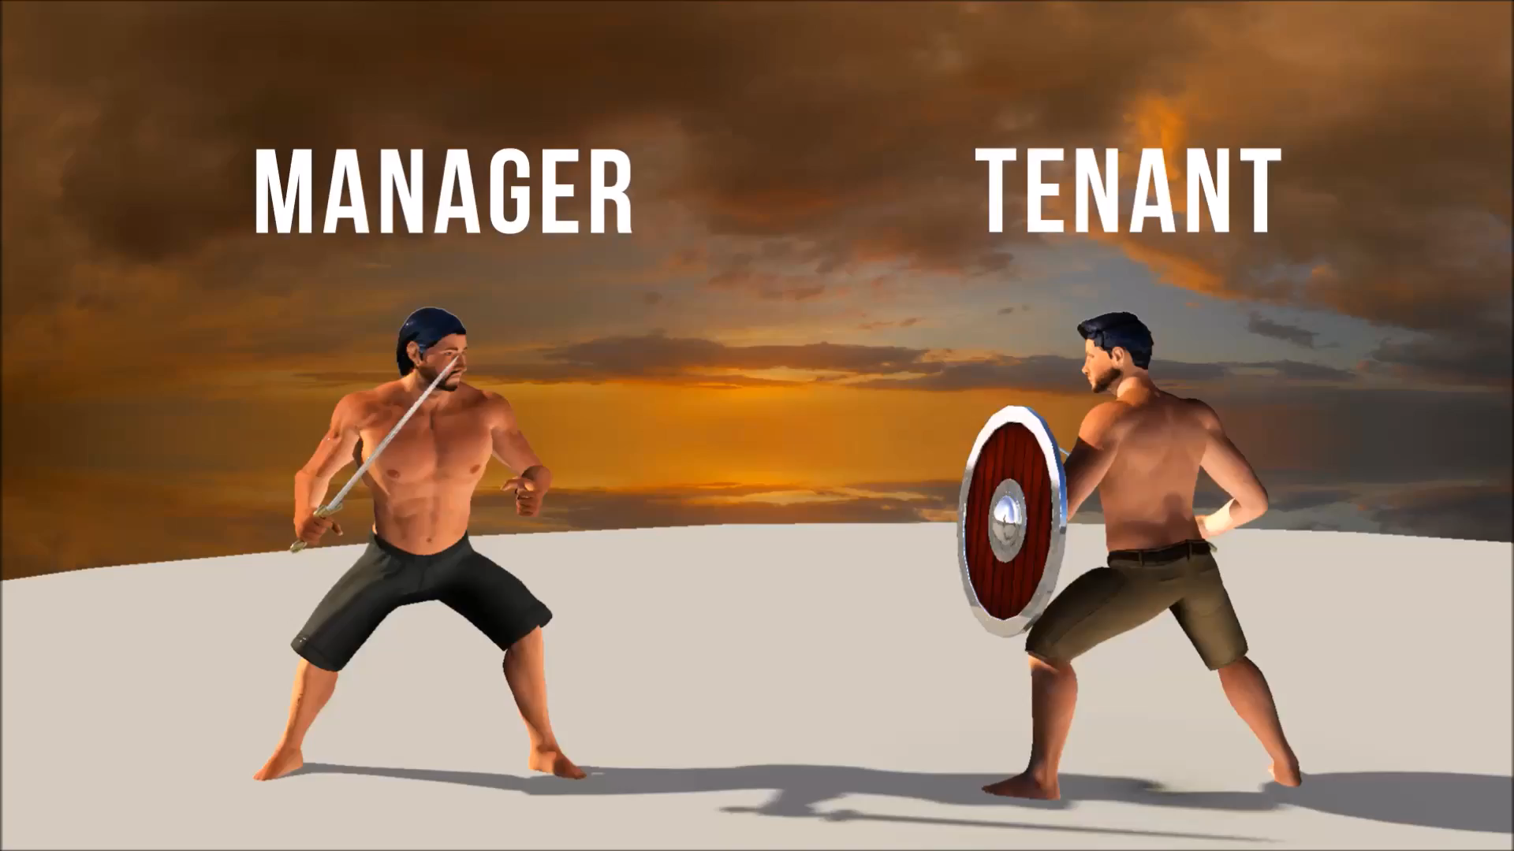

Slide 40
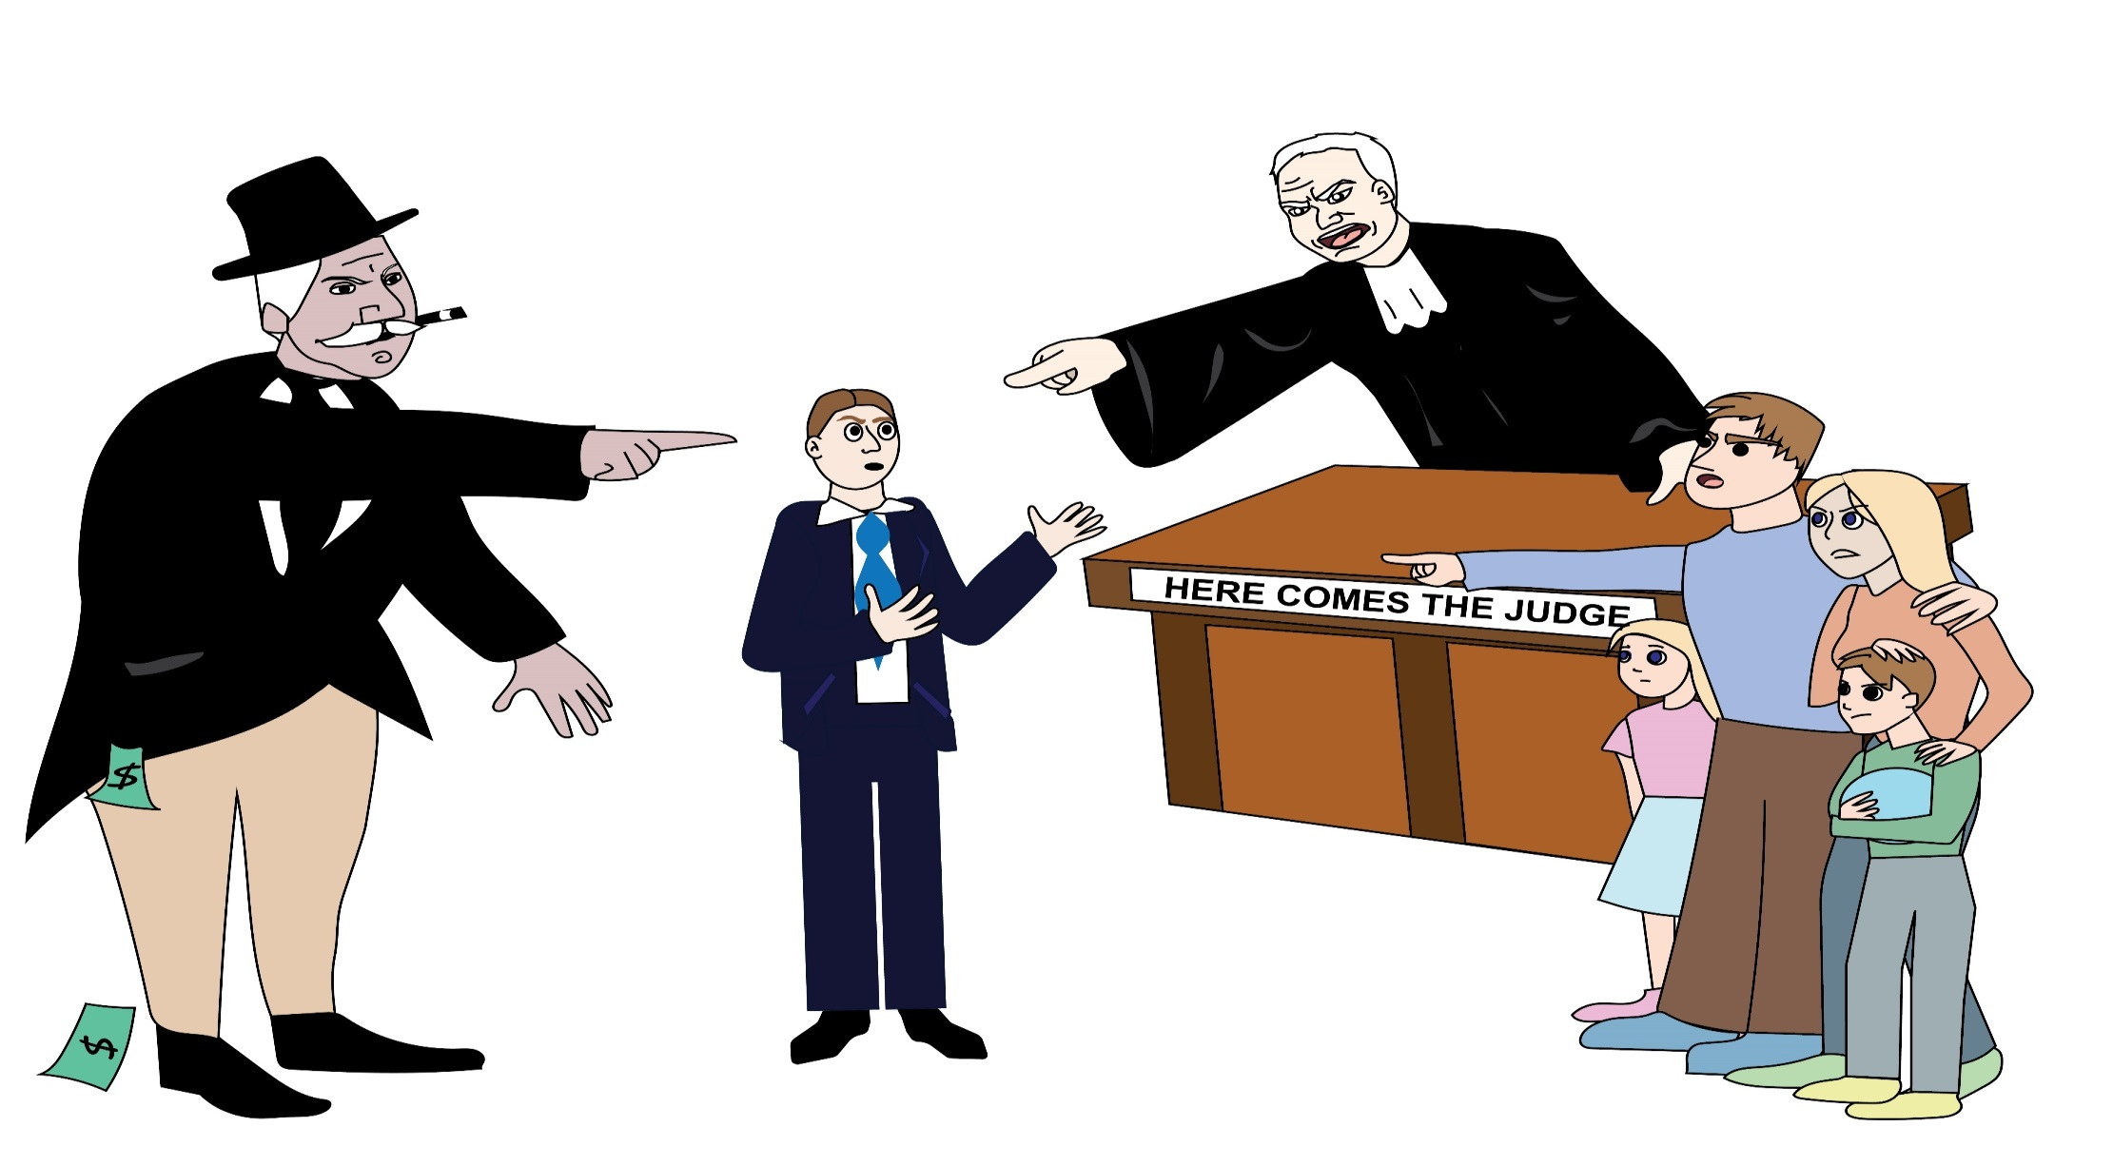

Slide 41

#3
Don’t Try to Bluff the Tenant Into Believing Things that aren’t True
“If tenant files Bankruptcy, the lease is void and tenant agrees to vacate the property.”

Slide 42
#3
Don’t Try to Bluff the Tenant Into Believing Things that aren’t True
If title changes, the lease is void
If tenant… they forfeit the security deposit.

Slide 43

Just because you say it
doesn’t make it true!

Slide 44

#4
Be Fair to Both Parties
“If resident breaches the lease, resident agrees to pay management’s attorney fees.
If management breaches the lease, management agrees to pay $1.”

Slide 45

Egregious
Unconscionable
Against
Public Policy

Slide 46

#5
Owner Can Terminate the Lease Early
It sounds fair on the surface
but the results on the parties are vastly different.
Either party can terminate the lease early

Slide 47



They both contribute
to breakfast
but the affects are very different.

Slide 48

#6
Things that Move
Staff names
Email addresses
Phone numbers
Methods of paying rent
WHY?
It’s going to change.

Slide 49

#7
Operational Issues
Eviction services
Tenant-screening company
Management software
How to request maintenance
WHY?

Slide 50

Move Operational Issues to a Housekeeping Document or Handbook
HOA
Pet issues
Roommate
Maintenance.

Slide 51

#8
Stop Attaching
Exhibits
Tenant handbook
Rental property condition report
Lead paint disclosure
Document creep
Tenant handbook
House rules
Harder to defend.

Slide 52

#9
Don’t Use Lease as a Data-Dispensing Form
Utilities
HOA contact
Rent payment methods
Staff phones
Eviction process.

Slide 53


#10
Signature Page Madness

Slide 54
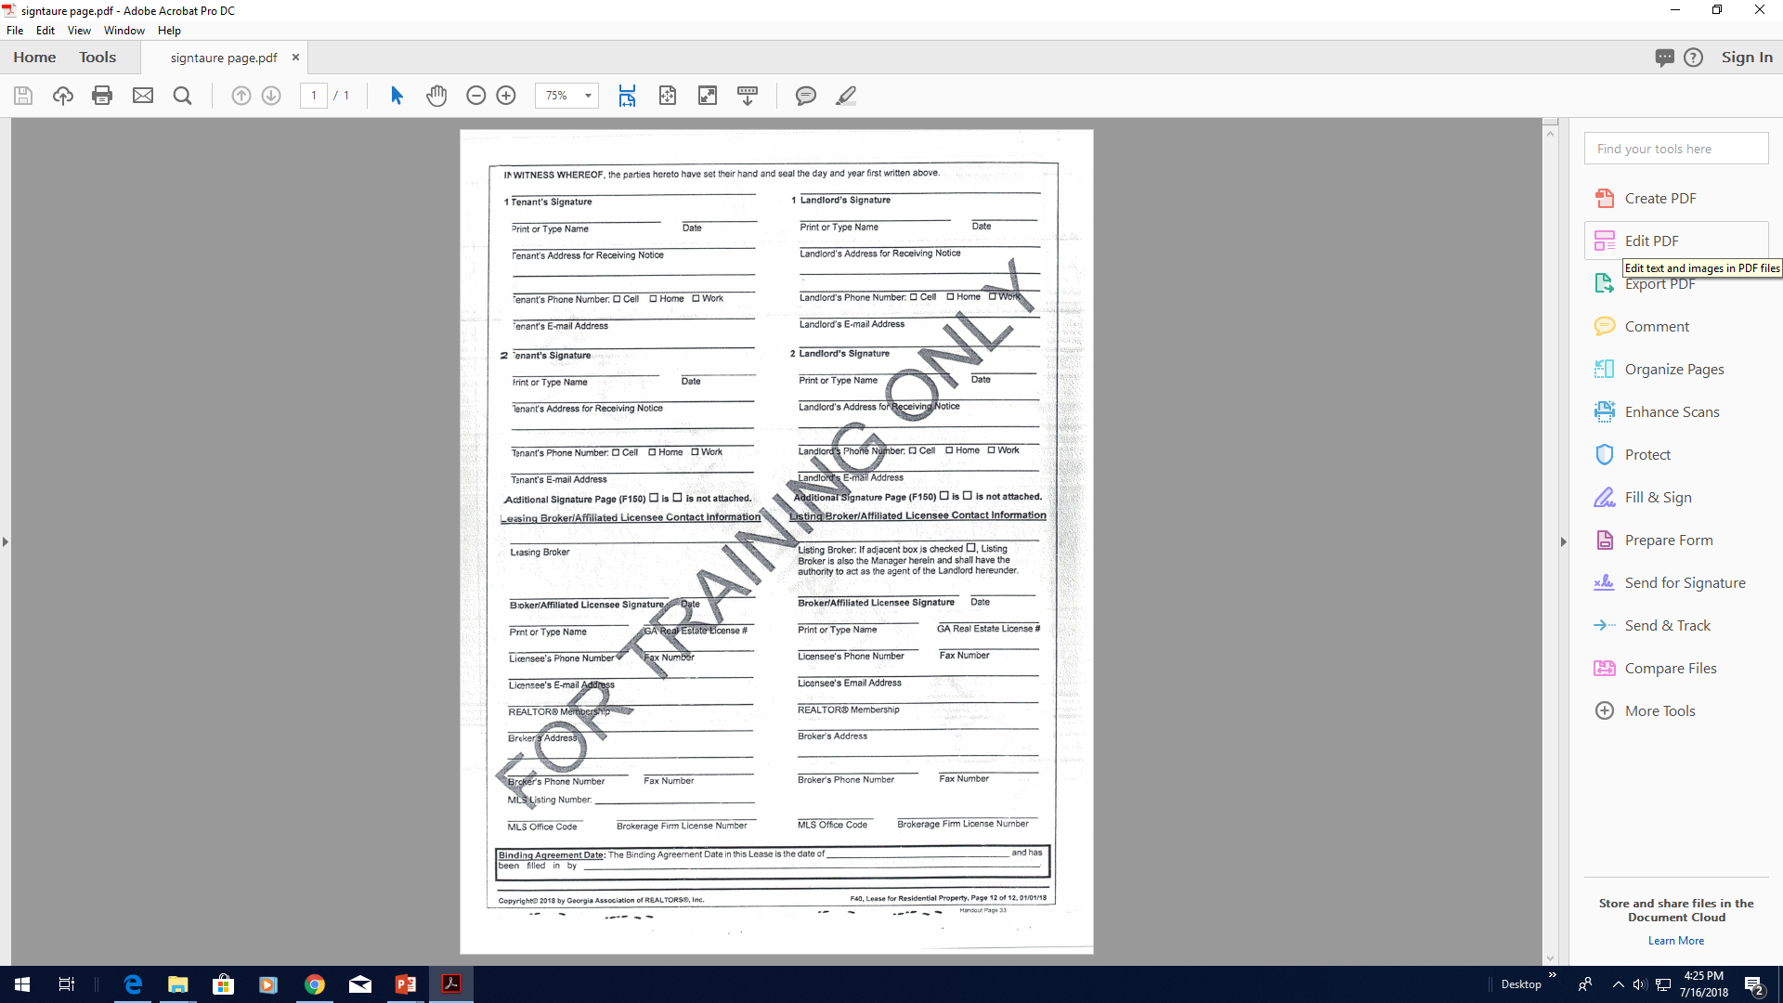

Slide 55
#10
Signature Page Madness
Data collection
Emails
Phone numbers
Co-oping agent
Use housekeeping
Simple signature page.

Slide 56
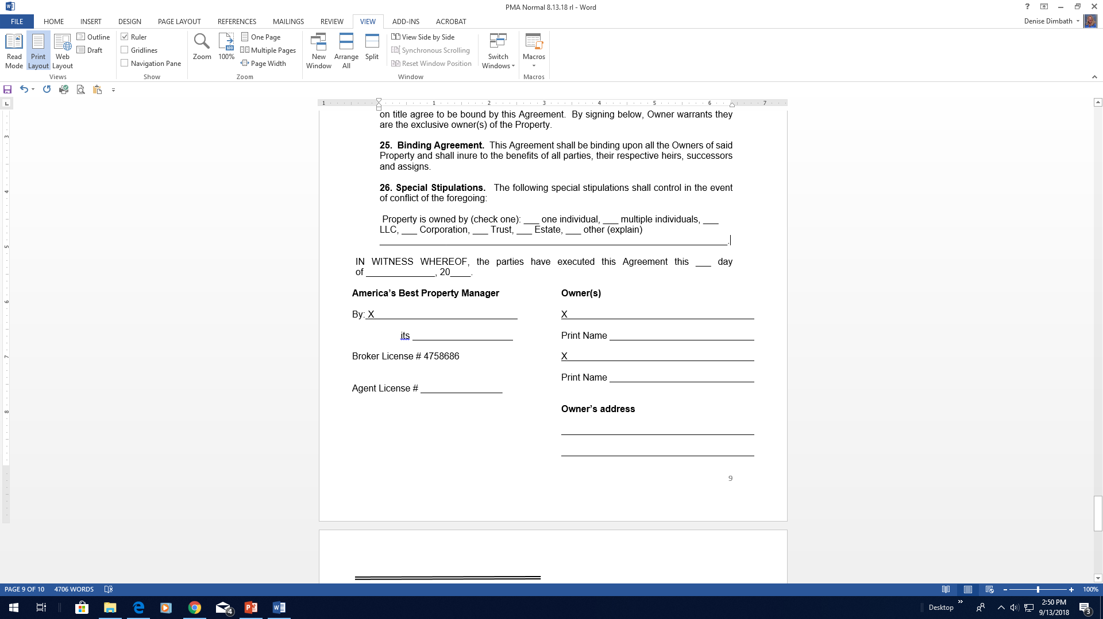

Slide 57
#10
Signature Page Madness
Structure your signature page to work 90% of the time.

Slide 58

Contractualizing
Everything

Slide 59
Things You ALWAYS Put in Your Lease

Slide 60

Mirror Your Landlord
Tenant Law
When you take the security deposit
Move-in inspection
Duty to repair
Timely move-out inspection
Return deposit
Eviction process.

Slide 61

But I’ve been doing this for 10 years!
Don’t count on that argument.
Notes:
61

Slide 62

Manage Your Labels
Owner’s name (hereinafter “Owner”/Landlord)
Manager’s name (hereinafter “Manager”/Broker/Agent)
Property address (hereinafter “Property”/”Premises”)
Be consistent.

Slide 63

Make a Case
NOT using the label “Agent” or “Broker” to identify yourself in your property management agreement or lease.

Slide 64


We all interpret words from
past experiences
Abortion
NRA
Terrorist
Immigrant
Agent/broker.

Slide 65


Slide 66
What do we know about
the public perception of
Agent or Broker?
Assistant, scribe
Make NO decisions.

Slide 67
Using “Manager”
Forces readers to examine the document to figure out what authority the Manager has.

Slide 68

About Early Move Ins
Start date and move in date don’t have to match
Encourage them to take possession early
Don’t prorate rent
Makes preparing leases easier.

Slide 69
About Early Move Ins
If the owner asks
Vacant houses invite vandalism
Gets the tenant more fully committed
Gets security deposit
Lawn care and utilities.

Slide 70

Set Up for Auto Renewal
People are creatures of habit
If neither party notifies the other
Resist month-to-month
Consider a 5-year lease
Stop resigning leases.

Slide 71

Current Revenue and
Company Value is Affected
Long-term occupants make you money
Set up your lease to keep them there
Reduces labor
Keeps owners.

Slide 72

Entire Agreement
This Agreement, plus Exhibits and Addendums executed by the parties from time to time, constitutes the entire Agreement between the parties and no oral statements, flyers, website copy, advertisements, brochures, property flyers, emails, texts, company handbooks, policies or representations shall be binding on either party and are not part of this Agreement.

Slide 73
Entire Agreement
Four Corners Language
You defeat this protection by adding special stipulations, exhibits, handbooks and policies.

Slide 74

Exculpatory Language
Indemnify
Hold harmless
Agreement not to sue
Sole gross negligence
CYA/Body Armor.

Slide 75

Mirror your landlord tenant law
Be consistent with labels
Use Manager and not Agent/Broker
Allow early move ins
Set up for auto renewal
Don’t add exhibits or handbooks.

Slide 76
Robert@
TrainingProperty Managers.com
Monica.Gilroy@
GilroyFirm.com

